Slide 1
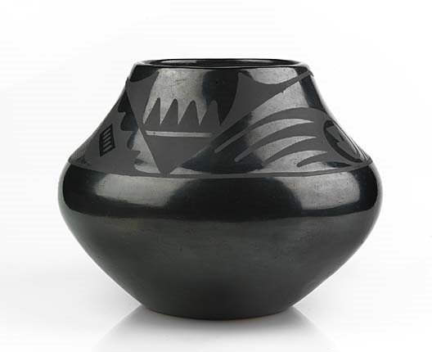
Native American Art
Maria Martinez
Born: San Ildefonso Pueblo, New Mexico 1886
Died: 1980
Julian Martinez
Born: San Ildefonso Pueblo, New Mexico 1879
Died: 1943

Slide 2
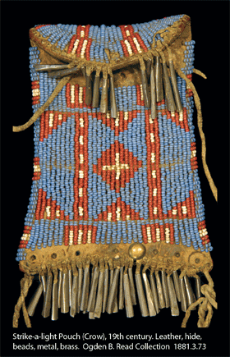

Slide 3
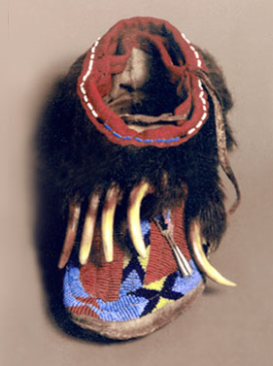
Grizzly Bear Moccasins
(Sioux)
19th Century
Rawhide, beads, metal, horsehair, grizzly bear claws,

Slide 4
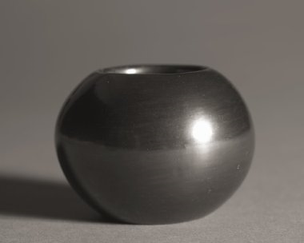
María Martinez
Vessel
1900s

Slide 5
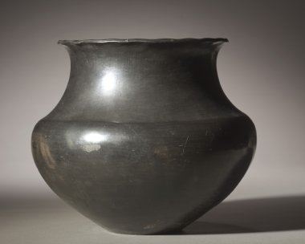
María Martinez
Blackware
1917

Slide 6
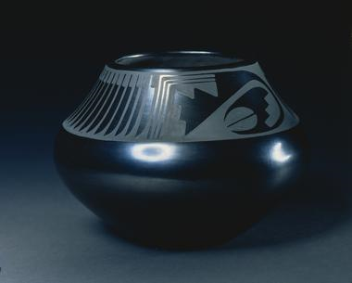
María Martinez
Bowl
c. 1940s

Slide 7
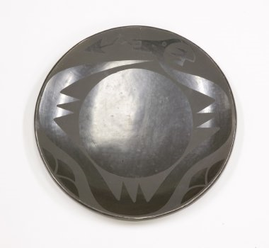
María Martinez, Julian Martinez
Blackware Plate
c 1930- 1932

Slide 8
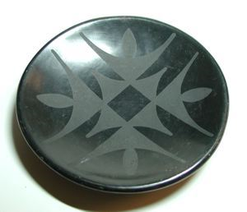
Maria Martinez
Bowl
Circa 1948
Blackware

Slide 9
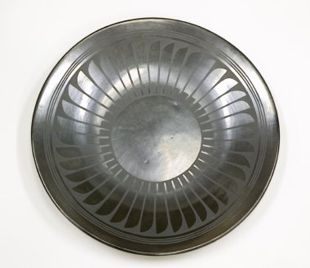
María Martinez, Santana Martinez
Plate with Feather Design
Santana Martinez 1945-1950

Slide 10
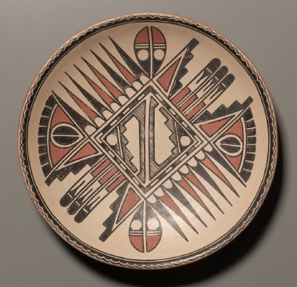
María Martinez
Plate

